Slide 1
Abuses of Statistics and Assessment of Statistical Investigations

Slide 2
Abuses of Statistics
The following are some common misuses and abuses of statistical methods in statistical reports, including:
1. Misrepresentation of statistical graphs
2. Misuses of averages
3. Inappropriate sampling methods or data collection
methods

Slide 3
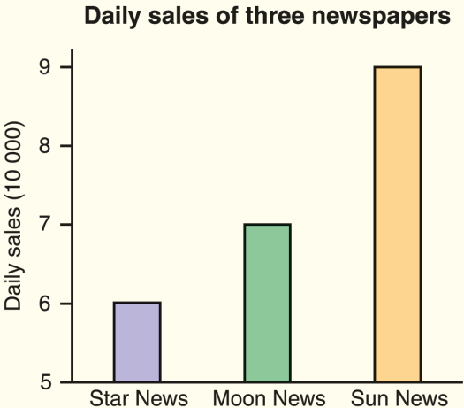
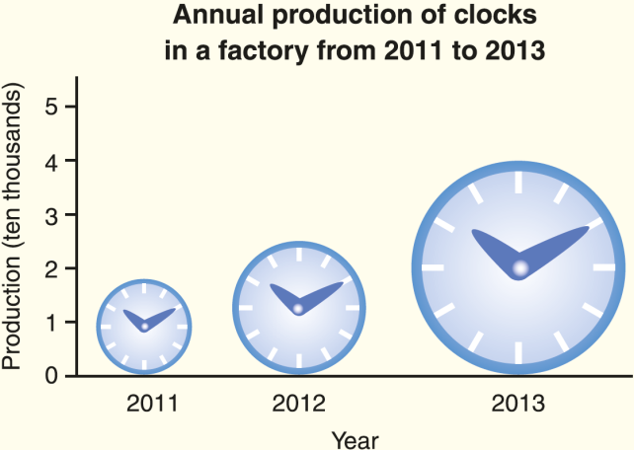
Misrepresentation of Statistical Graphs
We should pay attention to the following aspects when reading a statistical diagram:
(a) Whether the vertical axis starts from 0
(b) Whether the graphics used are in the appropriate proportions

Slide 4
Misuses of Averages
Arithmetic mean,
and mode are three commonly used averages.
median
As a result, the readers may be misled.
However, they are sometimes misused.

Slide 5



Inappropriate Sampling Methods or Data Collection Methods
If the sampling method or the data collection method is not suitable,
the sample obtained will not be representative
and the results obtained will be biased.
For example, if the sample size is too small, the results are likely to be biased.

Slide 6
Follow-up question
A social welfare organization wants to know elderly’s opinions about the social welfare system in Hong Kong. 1000 elderly were randomly selected and each received a questionnaire. Elderly voluntarily return the questionnaires without paying postage.
(a) Is this sampling method appropriate? Explain your answer.
(b) What is the disadvantage of collecting data
using the above method?
(c) Suggest a possible way to improve the above data collection method.

Slide 7
(a) Is this sampling method appropriate? Explain your answer.
(b) What is the disadvantage of collecting data using
the above method?
(c) Suggest a possible way to improve the above data collection method.
(a) No, this sampling method is not appropriate because
elderly may have reading and/or writing problem. They
cannot finish the questionnaire on their own. As a
result, the data obtained may be biased.

Slide 8
(a) Is this sampling method appropriate? Explain your answer.
(b) What is the disadvantage of collecting data using
the above method?
(c) Suggest a possible way to improve the above data collection method.
(b) The respond rate may be very low. / Elderly with strong
opinions will tend to respond, and the data obtained
may be biased.

Slide 9
(a) Is this sampling method appropriate? Explain your answer.
(b) What is the disadvantage of collecting data using
the above method?
(c) Suggest a possible way to improve the above data collection method.
(c) A face-to-face interview is a better method.

Slide 10
Assessment of Statistical Reports
We receive a lot of statistical information or statistical reports, which may contain information that is not clear or is misleading, especially in advertisements.
Therefore, it is important for us to develop the ability to recognize statistical information that is of low quality or which involves possible misuses of statistics.
The 6 questions in the following are useful in helping us to judge whether the statistical information is of good quality.

Slide 11

1. What are the objectives of the survey?
2. Who conducted the survey?
3. How was the survey conducted?
4. What is the size of the sample and what is the sampling method?
5. If the data is collected by questionnaires, are there any problems in the questions in the questionnaire?
6. Are the statistical diagrams correctly drawn?
Check whether the questions in the questionnaire satisfy the 9 points mentioned in the questionnaire design section.
A good statistical report should contain clear answers to the above questions.

